Slide 1
Arts,Science and Commerce College Mokhada
Infrared/Vibrational Spectroscopy
T.Y.BSc.(SemV)

Slide 2
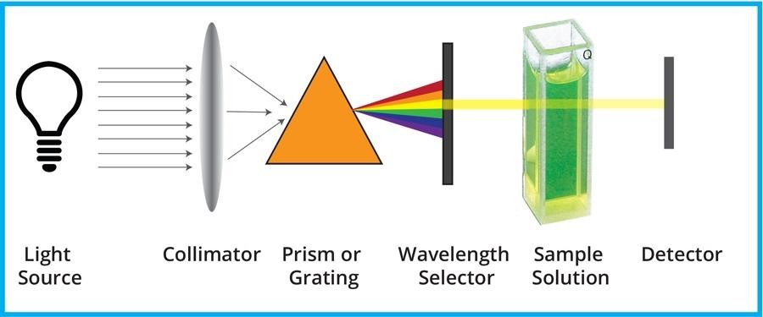
It is defined as the study of the interaction of electromagnetic radiation and matter.
Due to
interaction the incident of absorption or emission of
electromagnetic radiation by the molecules happens.
Output of the interaction provides data like frequency or wavelength of radiation and the intensity of radiation emitted or absorbed by the molecule.
In this way we can determine the size, shape, flexibility, electronic arrangement of the molecule means molecule structure studies.

Slide 3
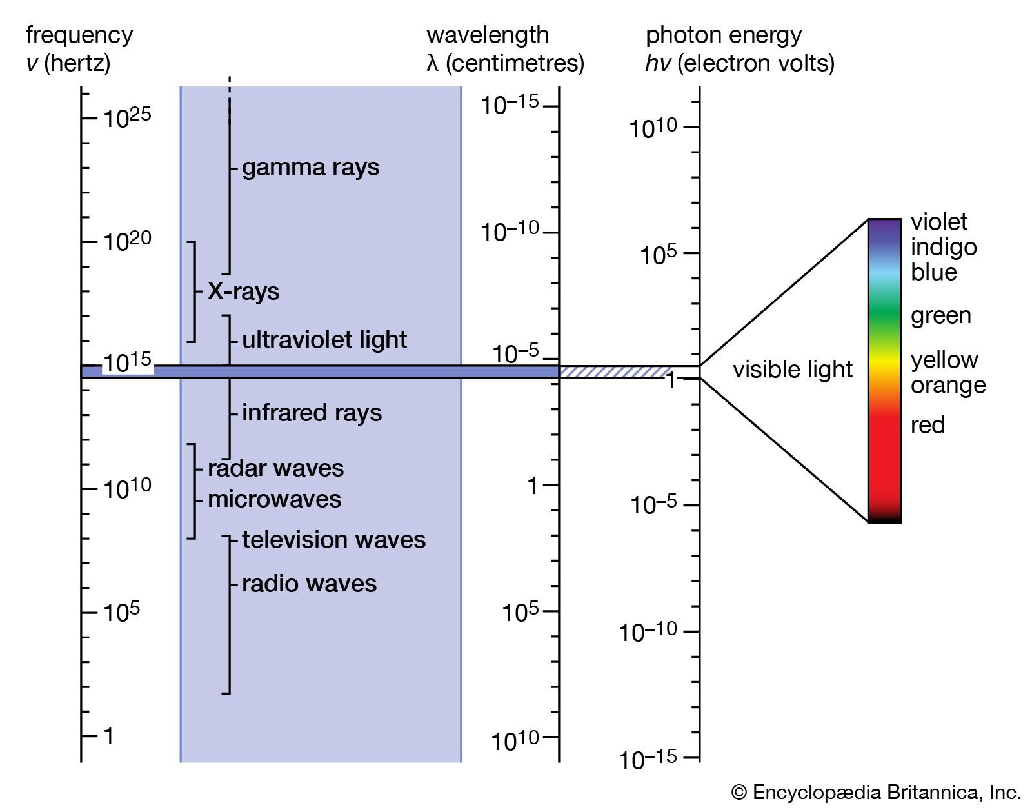

Slide 4
Different kind of spectroscopy
Microwave Spectroscopy.
Infrared Spectroscopy.
Raman Spectroscopy
Electronic Spectroscopy
Spin Resonance ( NMR and ESR Spectroscopy)
X-ray Crystallography
Mass Spectroscopy
Electron Microscopy
APPLICATIONS
Depending upon the frequency range they are classified. Each class has its unique set of application in Physics, Chemistry, Biology, Electronics, Biotechnology and other fields.

Slide 5
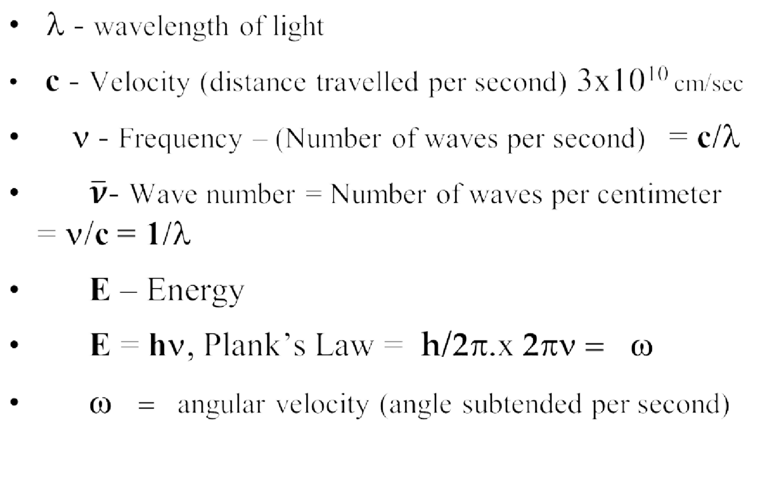
The main characteristics of Electromagnetic Radiation:
η

Slide 6
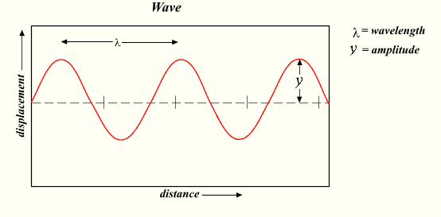
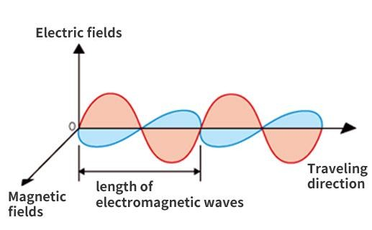
Wavelength, frequency and energy of radiation
Electronic radiation may be considered as a simple harmonic wave propagated from a source and travelling in straight lines.
Electromagnetic radiation associates electric and magnetic fields where both fields are perpendicular to each other and to the direction of propagation.

Slide 7
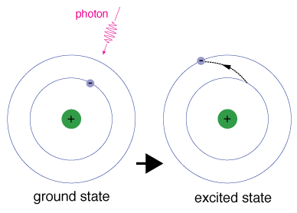
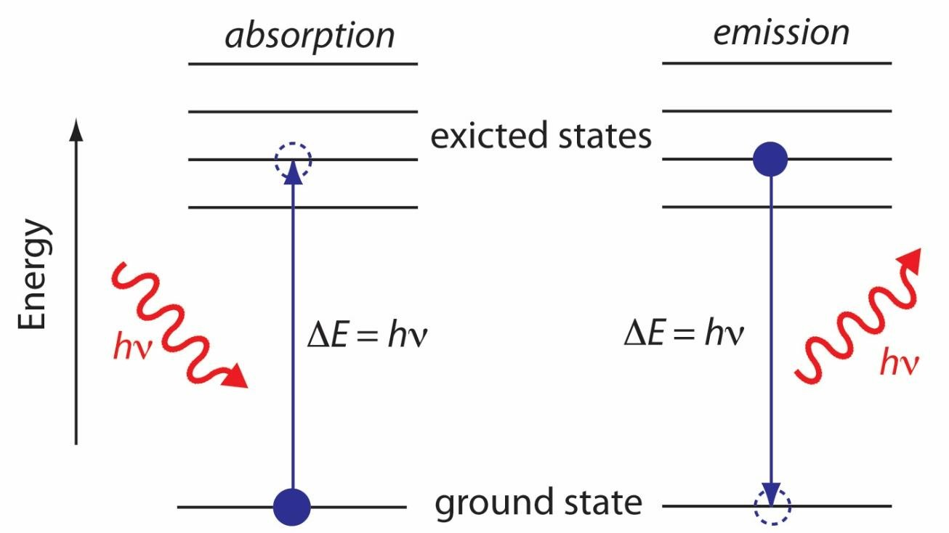
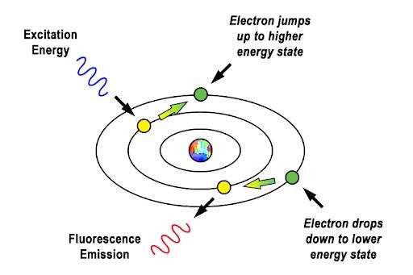
Absorption / Emission of Photons and Conservation of Energy
E_{g} - E_{e} =ΔE= hν
E_{e} - E_{g} = hν

Slide 8
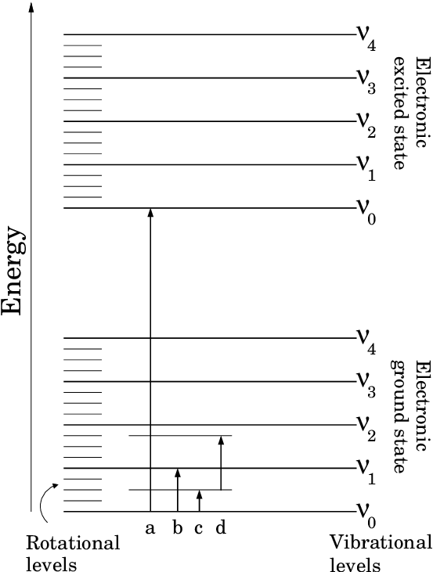
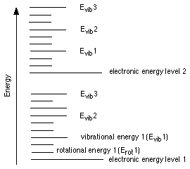
Energy levels of a molecule

Slide 9
Infrared/Vibrational Spectroscopy

Slide 10
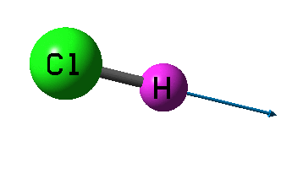
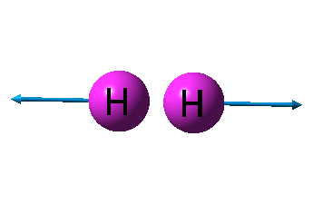
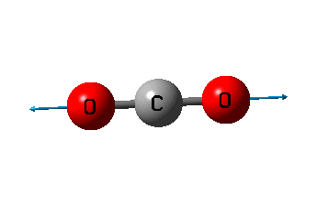
Vibrational (Infrared) spectrum
If the relative displacement of a molecular vibration about their mean position gives rise a dipole change along the direction of displacement during the vibration, molecule shows vibrational spectrum.
In order to be infrared active , there must be a dipole change during the vibration and this change may take place either along the line of symmetry axis or perpendicular to it

Slide 11
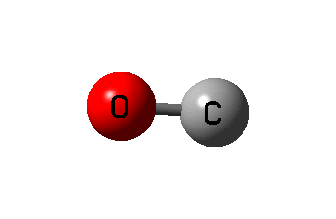
only in molecules
Vibrational spectra will be observable heteronuclear molecules since homonuclear have no dipole moment
If the atom is removed a distance from its equilibrium position, it experiences a restoring force that is proportional to its displacement from the equilibrium position. The molecule then behaves like a spring.

Slide 12
The spring which behaves in this manner is said to obey Hooke’s law:
f ∞ x
⇒
measure position,
f = − kx
of the displacement from the
x is the equilibrium
f is the force which the spring
imposes on atom. k is a proportionality constant called the force constant, it gives the restoring force from equilibrium position.

Slide 13
Negative sign is due to as x increases in one direction the force increases in opposite direction.
Hook’s law implies that the energy of the particle increases as the particle moves in either direction.
Let work that must be done to displace the particle a distance dx is f_{applied} dx, and this work is stored as potential energy U. Thus
^{dU = f}applied ^{dx}
Force f that the spring exerts on the particle and it acts against the applied force as f = - f_{applied}
dU = (− f )dx
This is an important Relation between force And potential energy.
dU
⇒
= − f
dx

Slide 14
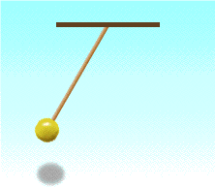
f = −kx
^{dU} = kx ⇒ dU = kxdx
dx
⇒ U = ¹ kx²
2
If after stretching length of the string is r and equilibrium
Length is r_{e} then
1
f = −k(r − r ) and U = k(r − r )
2
e e
2
If we want to describe the motion of the particle then we may use Newton’s law as f = ma as
d ² x _{⇒ −}
kx = m
dt ²
kx = mx
&

Slide 15
x = A cos(2πωt + ϕ)
this equation has the solution of the form
The correctness of this solution can be verified by substituting This and its second derivative back into the differential equ.
When this is done one obtain an equality if
− 4π ²ω ²m = −k
⇒ ω = ^{1 k} Hz
2π m
1
^{k} _{cm}−1
ω =
2πc m
This shows that a particle with mass m held by a spring with Force constant k will vibrate with frequency ω.

Slide 16
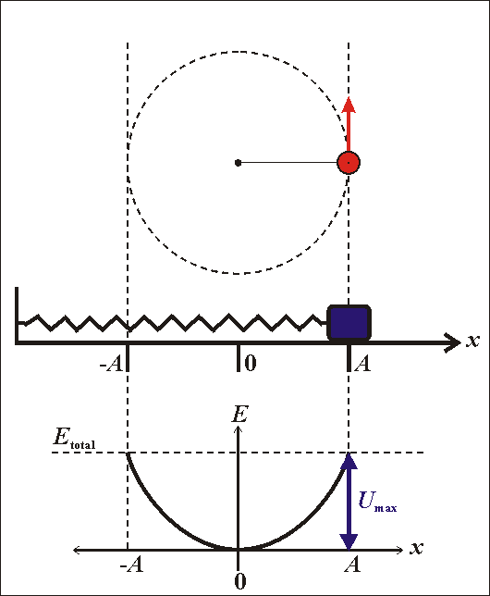
SHM and Uniform Circular Motion
Springs and Waves behave very similar to objects that move in circles.
The radius of the circle is symbolic of the displacement, x, of a spring or the amplitude, A, of a wave.
^{x}spring ^{= A}wave ^{= r}circle

Slide 17
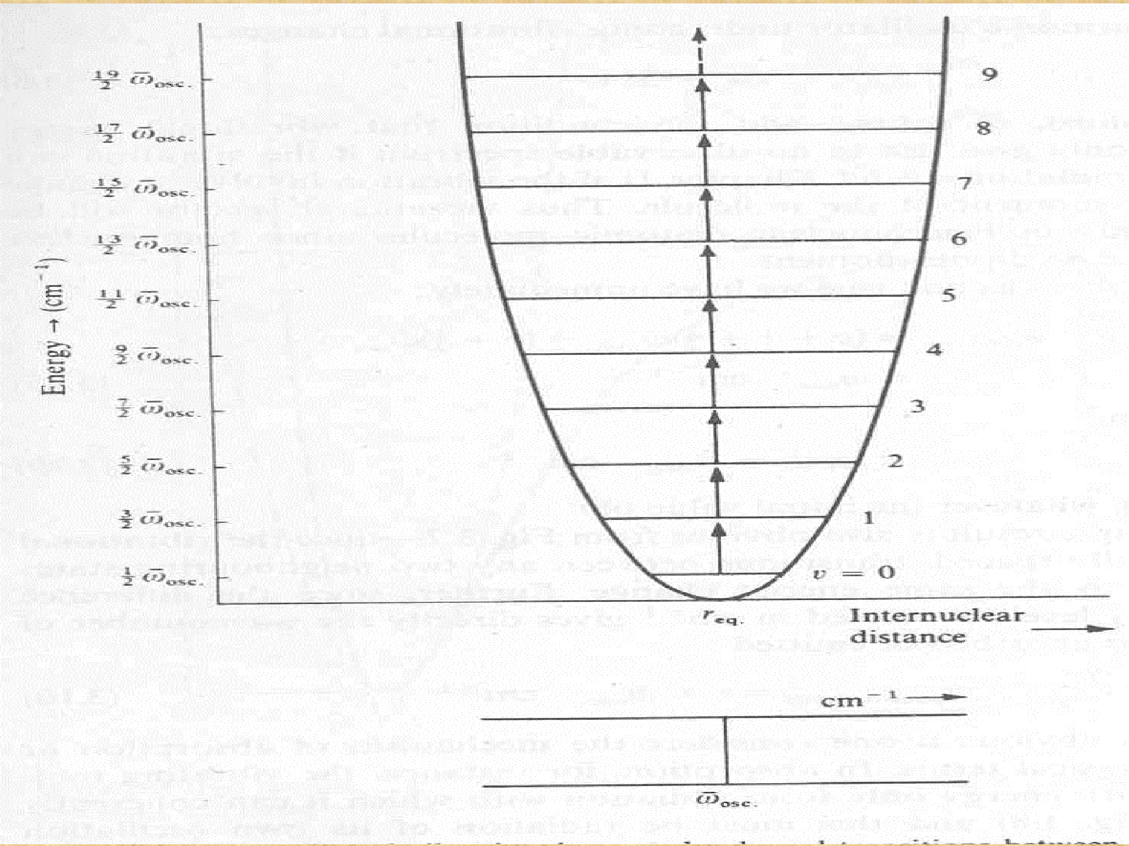
H’
H’’
Cl
ε₅
Cl
ε₁
H’
H’’

Slide 18
The simple Harmonic Oscillator
In spectroscopic units
ε_{v} = ( v + ½ ) ϖ_{osc} cm⁻¹ ………………………(3) The lowest energy obtained by putting v = 0 is
ε₀ = ½ ϖ_{osc} cm⁻¹
Implication from this result is that diatomic molecule( indeed any molecule) can never have zero vibrational energy; the atoms can never be completely at rest relative to each other.
The quantity ½ ϖ_{osc} cm⁻¹ is known as the zero point energy.
Selection Rule: Δ v = ± 1
Vibrational energy changes will only give rise to an observable spectrum if the vibration can interact with radiation.

Slide 19
The simple Harmonic Oscillator
Applying the selection rule we have immediately:
^{ε} v+1→v
= ( v+1 + ½ ) ϖ_{osc} - ( v + ½ ) ϖ_{osc} = ϖ_{osc} cm⁻¹
for emission and
^{ε} v → v+1
of v.
= ϖ _{osc} cm⁻¹ for absorption, whatever the initial value
Such a simple result is obvious as vibrational levels are equally spaced, Transitions between any two neighbouring states will give rise to same energy change.
^{ν} spectroscopic
=ε = ϖ _{osc} cm⁻¹ The vibrating molecule will
absorb energy only from radiation with which it can coherently interact and this must be radiation of its own oscillation frequency.

Slide 20
H’
H’’
Cl
ε₅
Cl
ε₁
H’
H’’

Slide 21
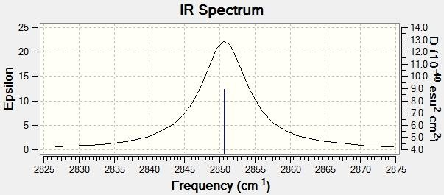
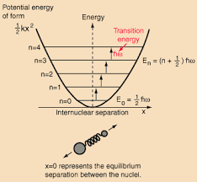
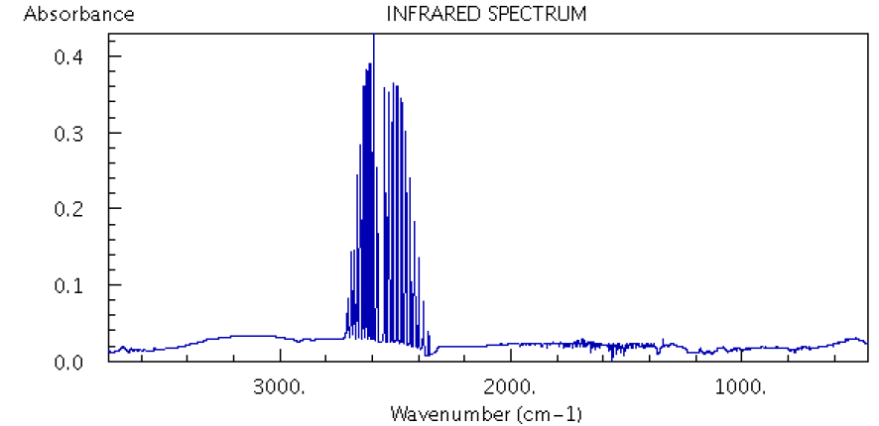

Slide 22
The Anharmonic Oscillator
Real HCl do not obey the laws of simple harmonic motion. If the bonds between the atom is stretched , there comes a point at which it will break- the molecule dissociates into atoms.
The purely empirical expression which fits the anharmonic curve to a approximation was derived by
P.M. Morse, and is called the Morse function:
V(r) = D_{eq}.[ 1 - exp { a ( r_{eq} - r)}]², where a is a constant for a particular molecule and D_{eq} is the dissociation energy.

Slide 23
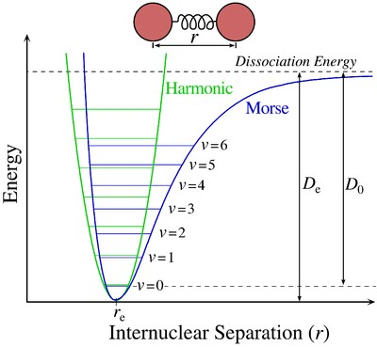

Slide 24
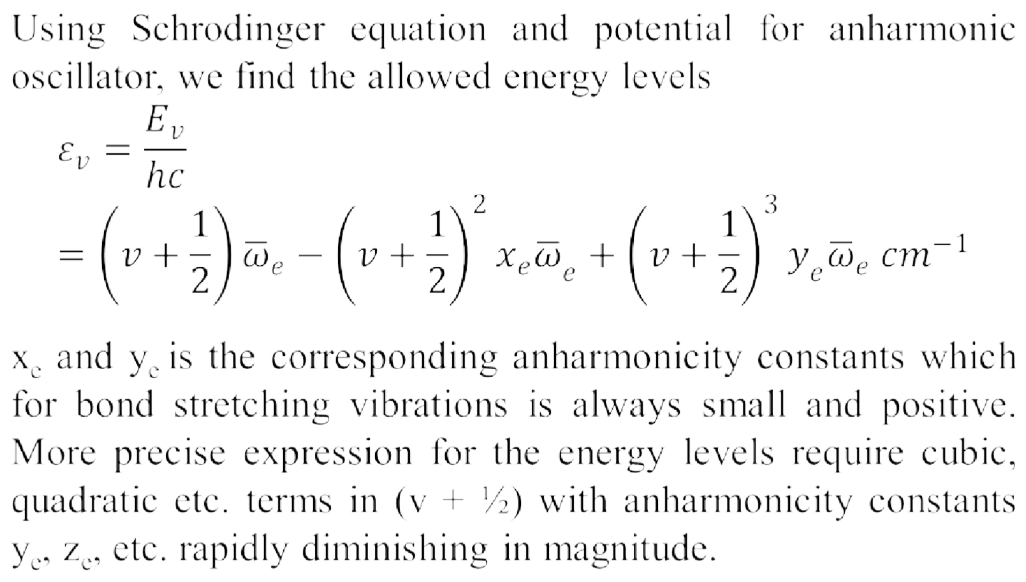
Selection Rules: Δ v = ± 1, ± 2, ± 3,…….

Slide 25
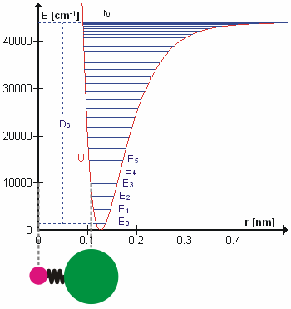
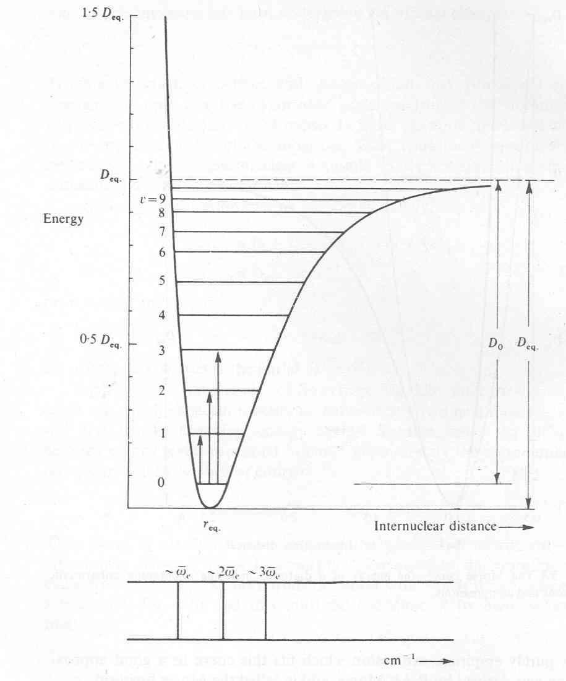

Slide 26
1. v=0→v=1, Δv = + 1 with considerable intensity.
Δε = ε_{v=1}
^{- ε}v=0
= (1 + ½ ) ϖ_{e} - (1 + ½ )² ϖ_{e} x_{e} - {½ ϖ_{e} -(½)² ϖ_{e} x_{e} }
= ϖ_{e}( 1 - 2 x_{e})cm⁻¹ ……………………(a)
2. v=0→v=2, Δv = + 2 with small intensity.
Δε = ε_{v=2}
^{- ε}v=1
= (2 + ½ ) ϖ_{e} - (2 + ½ )² ϖ_{e} x_{e} - {½ ϖ_{e} -(½)² ϖ_{e} x_{e} }
= 2ϖ_{e}( 1 - 3 x_{e})cm⁻¹

Slide 27
3. v=0→v=3, Δv = + 3 with considerable intensity.
Δe = ε _{v=3}
^{- ε} v=0
= (3 + ½ ) ϖ_{e} - (3 + ½ )² ϖ_{e} x_{e} - {½ ϖ_{e} -(½)² ϖ_{e} x_{e} }
= 3 ϖ_{e}( 1 - 4 x_{e})cm-1 ……………(c)
To a good approximation since x_{e}≈ 0.01, the three spectral lines lie very close to ϖ_{e},2 ϖ_{e} and 3 ϖ_{e}. They are known as fundamental absorption, first overtone and second overtone respectively.
Example: For HCl molecules we have three peaks at at 2886 cm⁻¹, at 5668 cm⁻¹ and at 8347 cm⁻¹
,

Slide 28
The Vibrations of Polyatomic Molecules.
The spectrum of polyatomic molecules is quite complex.
Fundamental Vibrations and their Symmetry:
For a molecule containing N atoms, 3N coordinate values are required to define it completely. If 3N coordinates are fixed then the bond distances and bond angles of the molecule are also fixed then Molecule is said possessing 3 N degree of freedom.
Degrees of freedom is a general term used in explaining dependence on specific parameters and implying the possibility of counting the number of those parameters.

Slide 29
If the molecule is free to move in three dimensional space without change of shape such that the molecule has only translational change. so the degrees of freedom will be 3N-3.
As there are 3 translations and rotations which do not form internal vibrations so we have
For Non-linear: 3N - 6 fundamental vibrations.
For Linear : 3N - 5 fundamental vibratons as rotation about the bond axis is restricted.
Since an N atomic molecule has N-1 bonds between its atoms, N-1 of the vibrations are bond stretching, the other 2N- 5(nonlinear) or 2N-4(linear) are bending motions.

Slide 30
Examples: For diatomic molecule, N=2, 3x2 -5 =1, only one fundamental vibration.
For water, N=3, 3x3-6 = 3 allowed fundamental vibrational modes.
These vibrational modes are also referred to as the normal modes of vibration of the molecule.
By utilizing the symmetry elements in the molecules each motion may be leveled symmetric or antisymmetric.

Slide 31
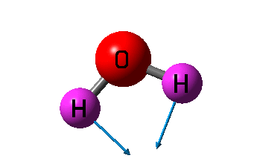
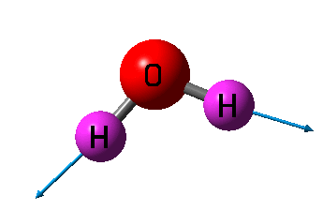
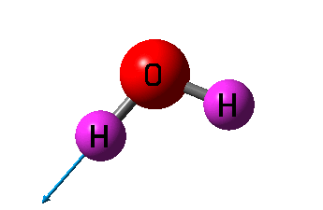
Bending
δ
Symmetric stretching
^{ν}S(OH)
Asymmetric stretching
^{ν}AS(OH)
# IR active modes frequency (cm⁻¹) | Intensity | Mode
1800.00 | 265.83 | δ
3810.00
10.00
^{ν}S(OH)
^{ν}AS(OH)
3945.00
70.84

Slide 32
